Slide 1
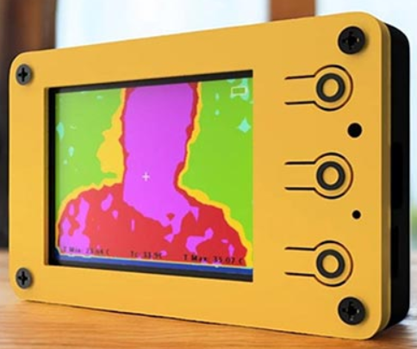
Thermal Sensing Camera

Slide 2
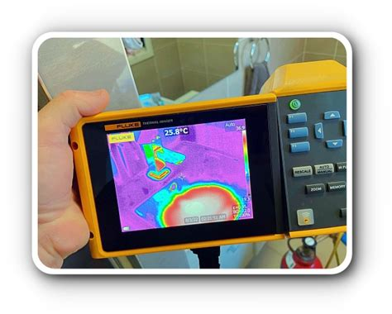
Project By:
Sasa Mardi ee23btech11222
Sai Preetam ee23btech11221
Abhey Garg ee23btech11202
Chirag Garg ee23btech11206
Prashant Maurya ee23btech11218

Slide 3
Introduction
A DIY thermal camera using an ESP32 microcontroller and an MLX90640 thermal sensor offers an affordable and portable solution for thermal imaging. This project enables real-time heat detection by capturing infrared radiation and converting it into a visual temperature map displayed on an OLED or TFT screen. The ESP32 processes data from the MLX90640 sensor via the I2C protocol, rendering a thermal image that highlights temperature variations in the environment. Powered by a lithium-ion battery, this compact thermal camera is ideal for applications such as detecting heat loss in buildings, monitoring electronic components for overheating, and temperature screening.

Slide 4
Major Components
IR SENSOR MLX90640 (32 x 24)
ESP32 Microcontroller
TFT Display(320 x 240)
Battery
SD Card

Slide 5
Features
Sensor field of view (FoV): 55°x35°
Temperature measurement range: -40 to 300°C
-40 to 85°C operational temperature range
Adjustable refresh rate – 4Hz – 32Hz.10 different colour pallets
5 different interpolation modes.
Easy to use GUI.
2.4” TFT display with 320x240 resolution
Built-in battery and charging circuit.

Slide 6
Power Input
3.3V Regulator
On/Off switch
Battery Charging
Display
LED Indicator
USB-UART/ Programming Circuit
ESP 32 SoC
Image Sensor
SD Card

Slide 7
Work Flow
Data Acquisition: The MLX90640 sensor continuously reads the infrared radiation from its environment and transmits the data to the ESP32.
Data Processing: The ESP32 reads the data from the thermal sensor, processes the temperature information, and formats it into a readable thermal image.
Image Display: The processed data is sent to the display, where it is rendered as a color-coded thermal image. Different temperatures are represented by varying colors or shades.
Power Management: The battery supplies power to the ESP32 and the sensor, making it a portable system that can be used in a variety of environments.

